Slide 1

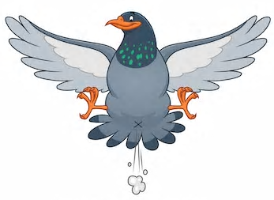
Azure Event Hubs & Streaming Analytics for IoT Solutions
SmartFreezer Device Simulation
Emmanuel Nuyttens
ConComCom – BlitZ Talks – June 2019

Slide 2
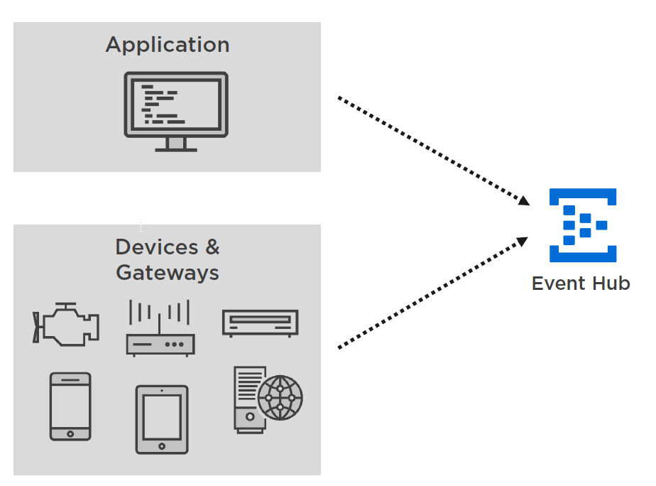
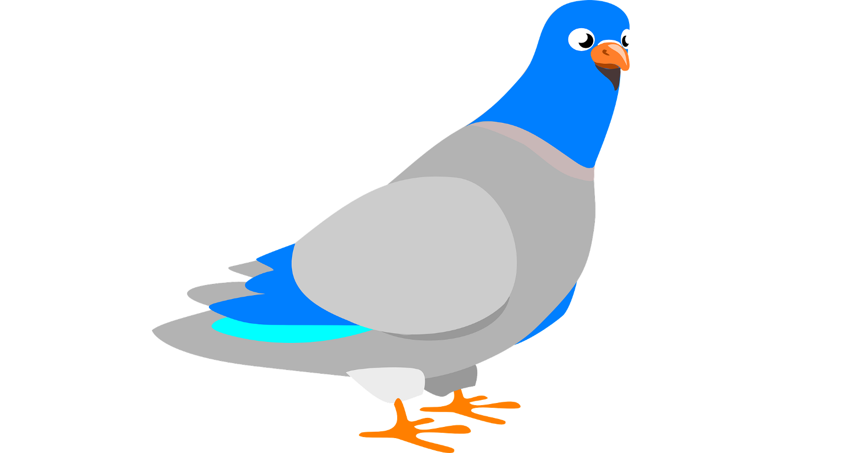
What are Event Hubs ?
Event hubs are typically “events” ingestors, which means that we can send event-data (e.g. telemetry data) from our applications, or more typically IoT enabled devices like a Raspberry Pi to a central ingestion point, called the Event Hub.

Slide 3
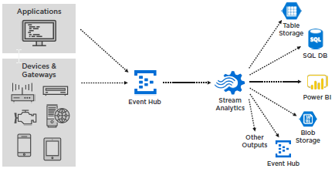
What are Streaming Analytics ?
With Stream Analytics, you can use a SQL-Like query syntax to read and analyze the events from the Event Hub. With Stream Analytics you can group and aggregate data to a certain output format and write the results of your query to an output that you have defined. The output can be for example Power BI.

Slide 4
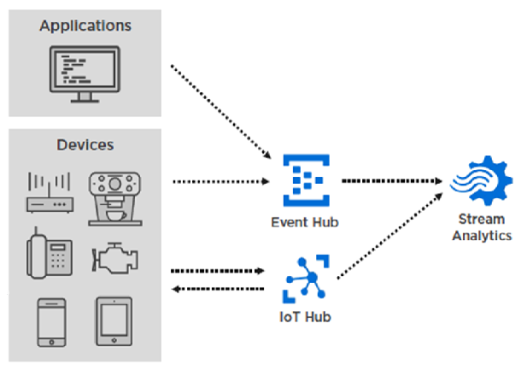
Event Hubs vs IoT Hubs
An Azure IoT Hub supports a similar concept as an Event Hub. You can also send events from your devices to an IoT Hub instead, which on their turn can also be consumed by a Stream Analytics job.

Slide 5
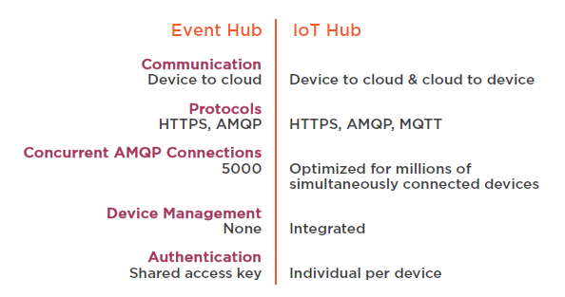
Main difference between Event/IoT Hub
So, to conclude, IoT Hub can be seen as a “specialization” of an Event Hub, in fact an IoT Hub contains an Event Hub “under the hood”, but adds device specific capabilities like device provisioning and cloud to device communication.

Slide 6
The Demo Scenario
The FAVV wants to collect data from the different Freezers in different Cities in Belgium to have answers to next questions (which can be seen as the requirements of our scenario):
For each freezer they want to know:
The current state (on/off).
The current and max content (in Kg).
The current temperature (in °C).
The current Cooling Liquid Level (in %).
Besides the requirements above, the FAVV CEO also wants to be notified when the maximum content of a freezer (in Kg) has been exceeded. In this case, he wants to get a message in his “Drop Box” account which shows the device id, freezer temperature and current and max content of the freezer.

Slide 7

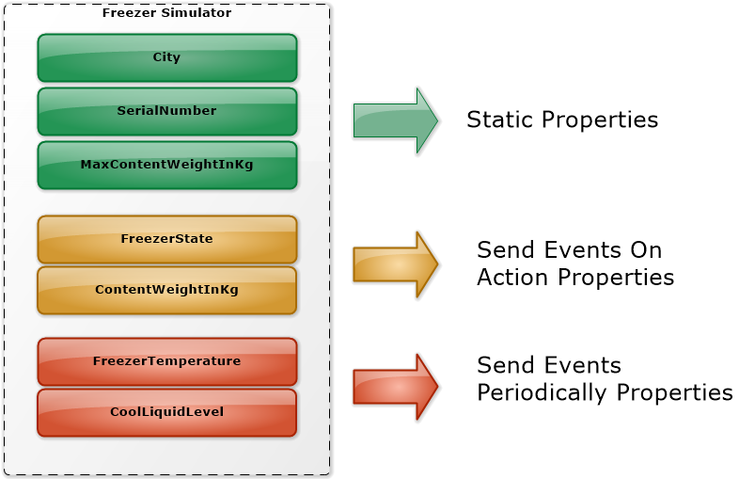
Freezer Simulator
We will send the different (simulated) sensor-values (current-state, current & max content, current temperature and cooling liquid level) to an endpoint in the cloud. This endpoint in the cloud will be an Event Hub. For our demo purpose, we won’t be using real IoT devices and freezer but simulate the freezer capabilities by means of a software application build in WPF !

Slide 8
Freezer Simulator Characteristics
Our Freezer Simulator will have next characteristics:
Static Properties (City, SerialNumber & MaxContent) : These are set at creation time and remain static (do not change).
Send Events on Action Properties (FreezerState, Content): Altering these properties will trigger a send_events message to the Event Hub.
Send Events Periodically Properties (FreezerTemperature, CoolLiquidLevel) : Propagating changes to this kind of properties will typically be done by a background task which periodically send the state to the Event Hub.

Slide 9
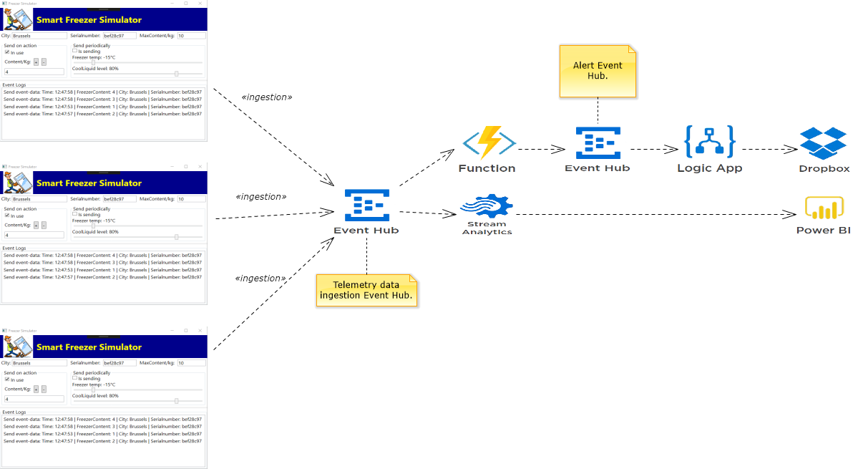
Analyzing, Processing & Reporting SmartFreezer Telemetry Data

Slide 10
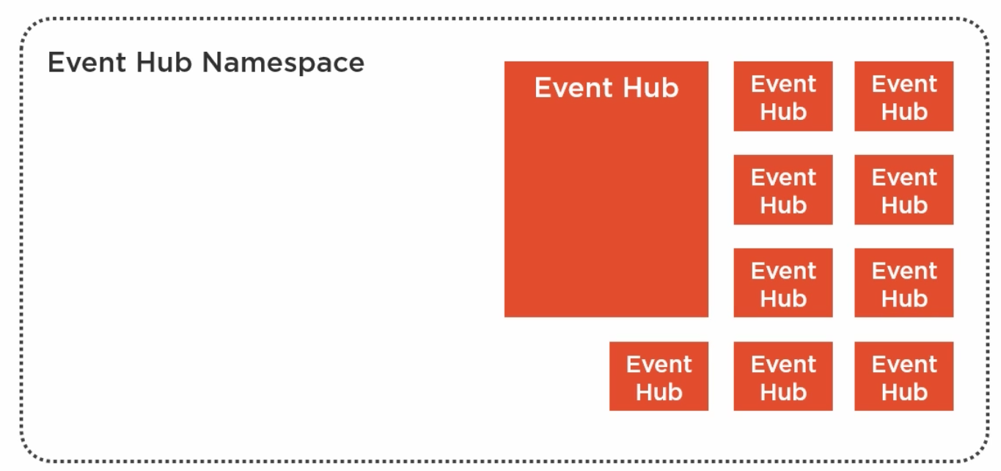
Event Hub Namespace
I started to create an Event Hub namespace and created an Event Hub in the Event Hub namespace. An Event Hub namespace can contain up to 10 Event Hubs. On the namespace level, we have selected just 1 Throughput Unit by default and which is the minimum number of Throughput Units you can choose.

Slide 11
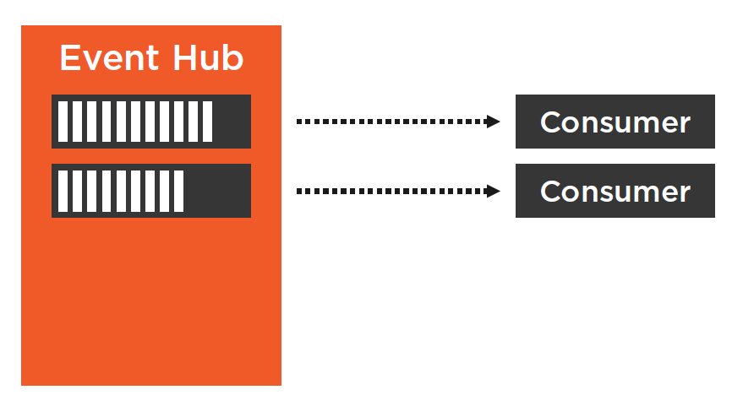
Understand Partitions
By default, when you create a new event hub you get 2 Event Hub partitions, which is the default value and also minimum number of partitions you can select.
But what is such a partition ? When senders are sending events to you Event Hub, these sent events are distributed to partitions by using a round robin model.

Slide 12

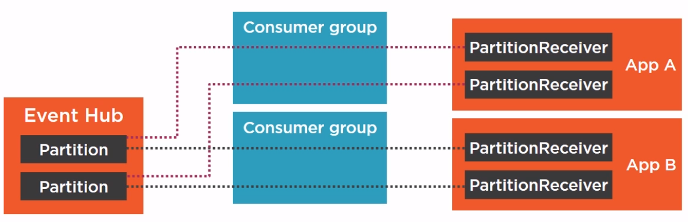
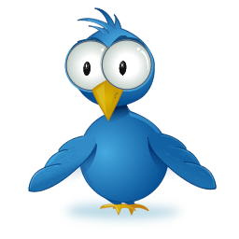
Understand Consumer Groups
Each Consumer Group provides the full event stream to the consuming application. This means that App A and App B can read independently from each other in parallel from the Event Hub.

Slide 13

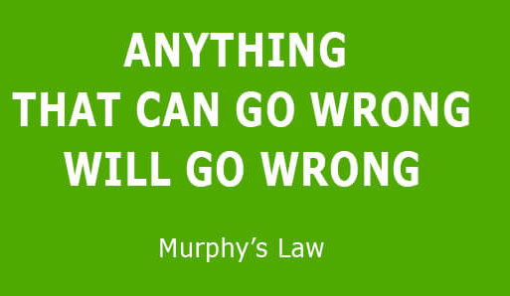
Let’s demo …

Slide 14
Any Question ?
Thank you !

